Slide 1
Images of Women: media stereotypes
1968 – 2018
Trevor Millum
www.readingpictures.co.uk
trevor@millum.myzen.co.uk

Slide 3
Visual communication in women’s magazine advertising Then….

Slide 4
…and Now.
What, if anything, has changed over the last 50 years?

Slide 5
And how would we know?
Spot the difference.

Slide 6
Q. How would we know? A. A big enough sample (200+), a detailed analysis.
Form
e.g. colour – cropping – focus – angle…
Content
Product
Props – functional – metaphorical – explicit - implicit
Setting – familiar – exotic – urban - rural
Actors – relationship – attention – tactility –– appearance (pose – expression - clothes – hair)

Slide 7
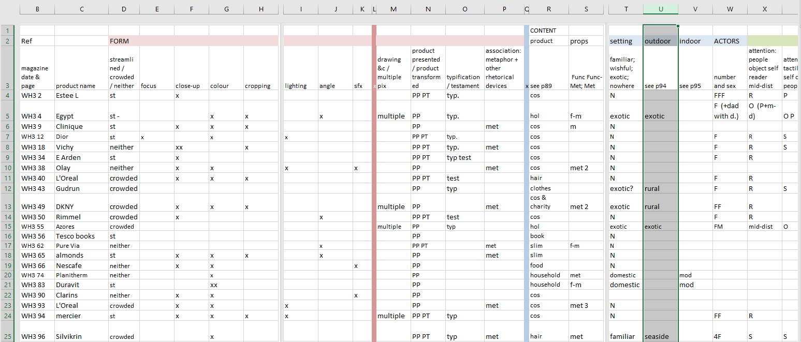
How to record the data?
From card index (then) to spreadsheet (now)

Slide 8
Form 1
Notes:
e.g. colour

Slide 9
Form 2
Notes:
e.g. style
Did vary with magazine to some extent. Colour even more dominant – glossier - less b/w, a cleaner/streamlined style

Slide 10
Content: the product
Notes:
Even so, similarities are remarkable

Slide 11
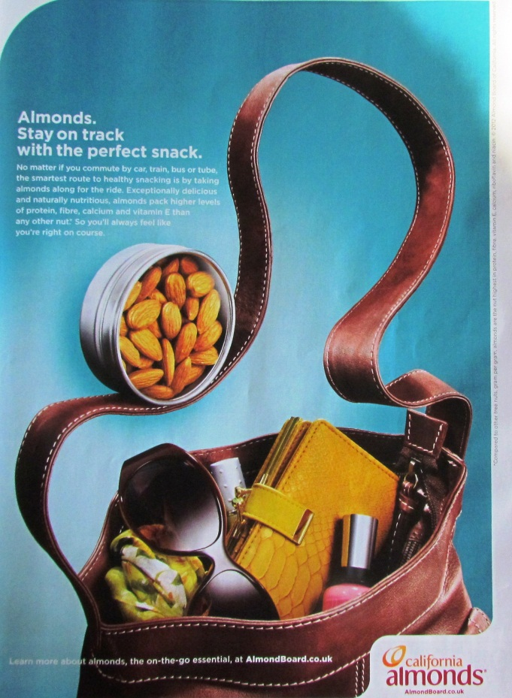
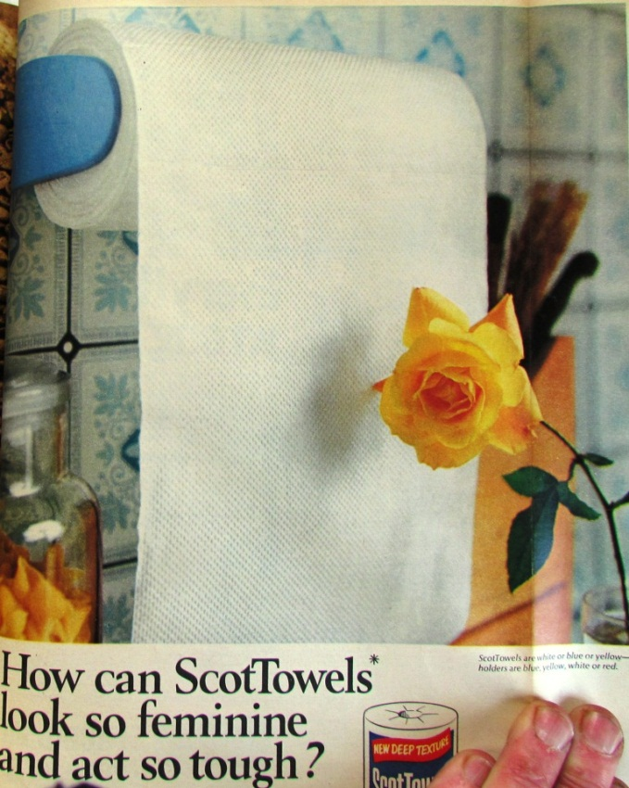
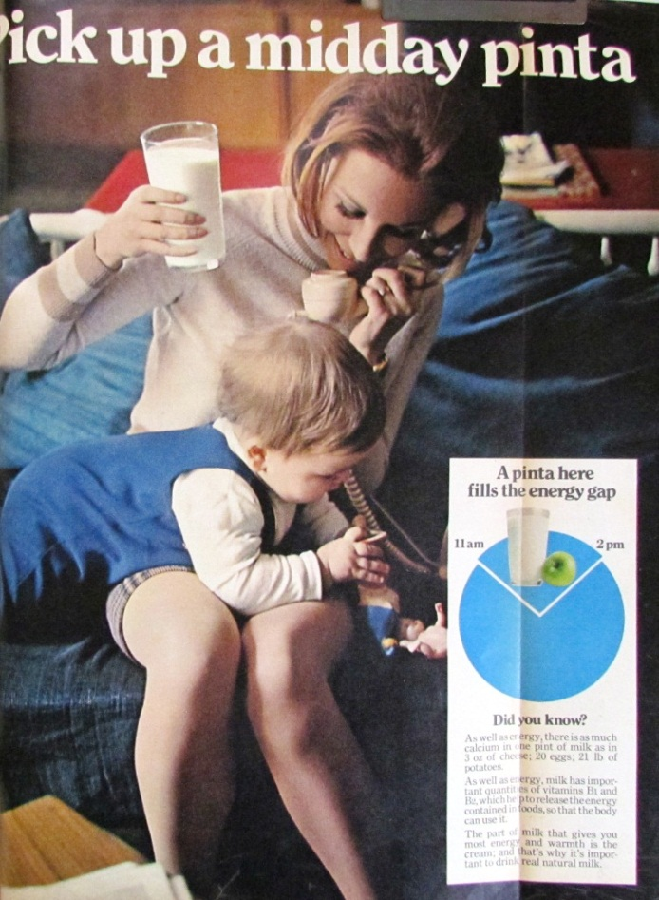
Content: Props
Notes:
Props – used throughout then and now. Two main categories: explicit and implicit. Explicit, often anchored by the text/headline in case you didn’t get it; implicit where the prop is there to imply a characteristic, most frequently sophistication, active lifestyle, luxury…

Slide 12
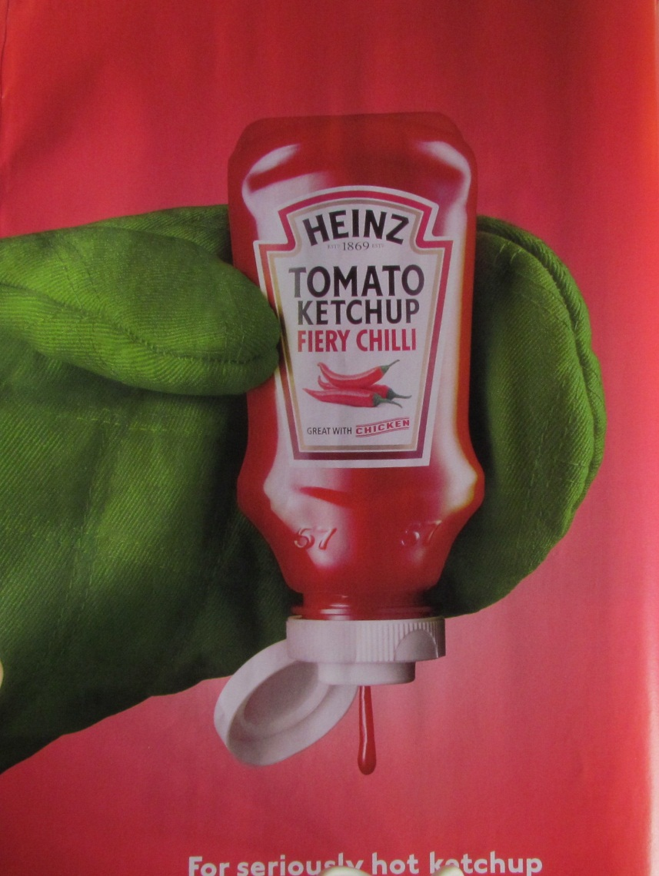
Metaphor

Slide 13
Content: Settings
Notes:
Similar to props: the obvious and the more subtle. I haven’t done the numbers but I think settings are less often used. The majority of products and actors are not situated anywhere (unlike TV ads). Is this to make it easier for ‘everywoman’ to identify? Exotic or wishful settings predominate then and now; even fewer familiar settings and no workplace ones.

Slide 14
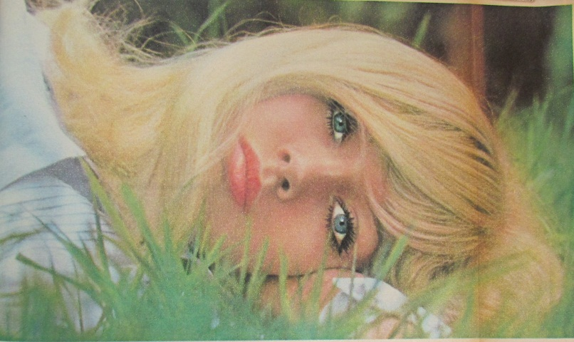
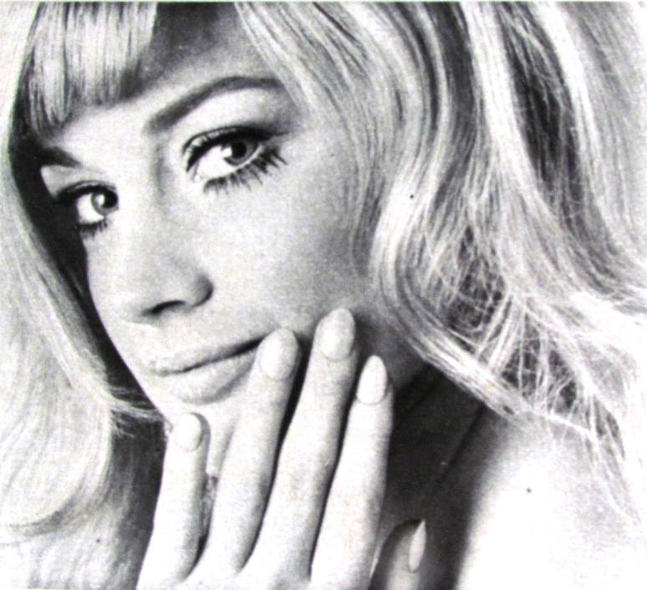
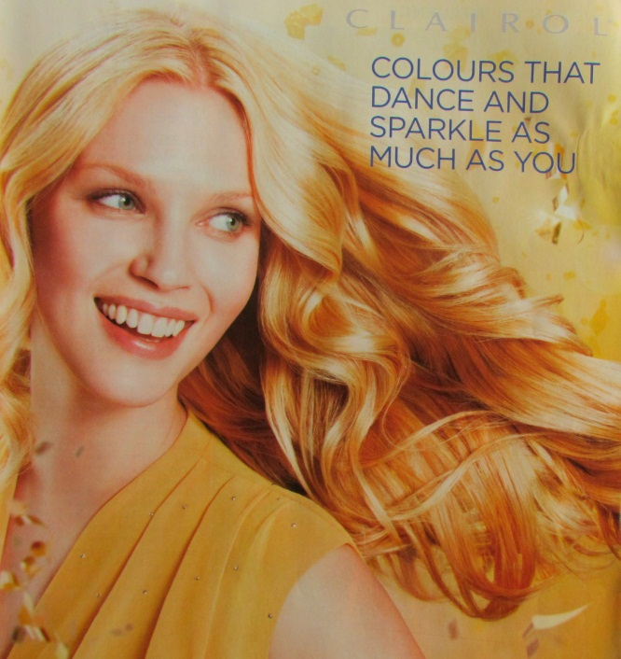
Content: Actors
Notes:
Subjective and objective – the issues.
People – Who? Almost entirely female
Alone or group – Relationship – Expression - Pose
Attention – looking at what, touching what? – Clothes - Hair

Slide 15
Wife / mother
Hostess
Free-spirit
Mannequin
Narcissist
Notes:
The categories that emerged

Slide 16
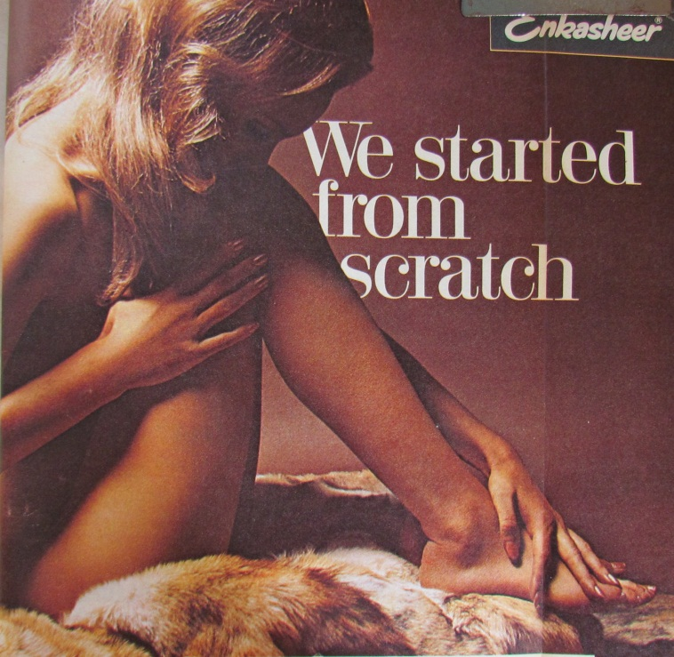
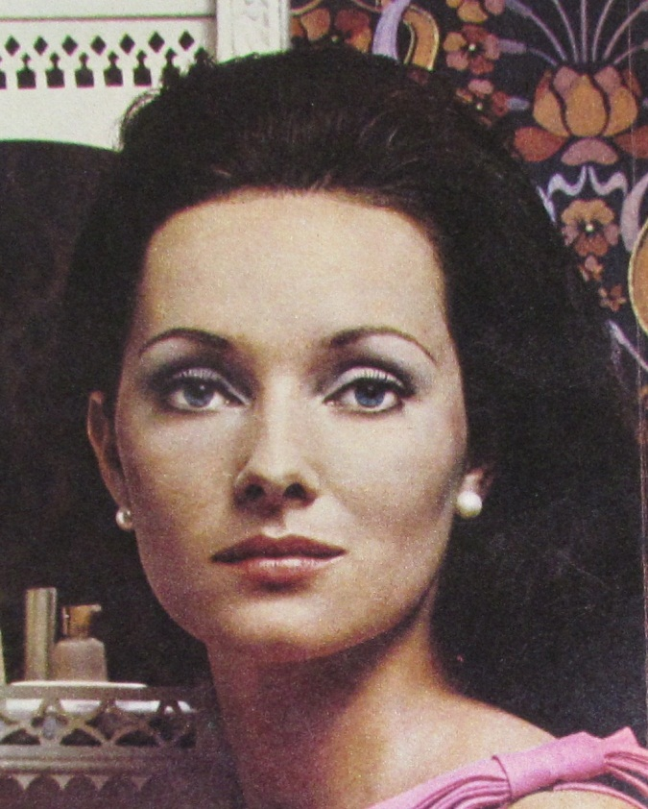
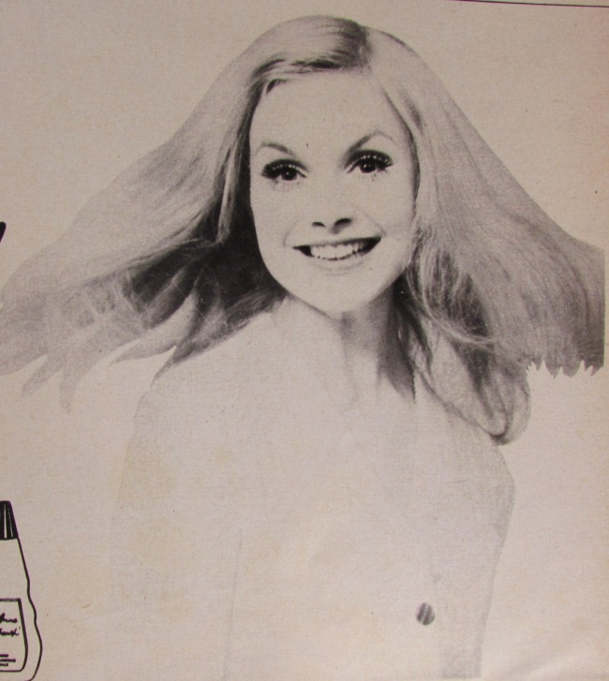
Notes:
Examples of the types

Slide 17
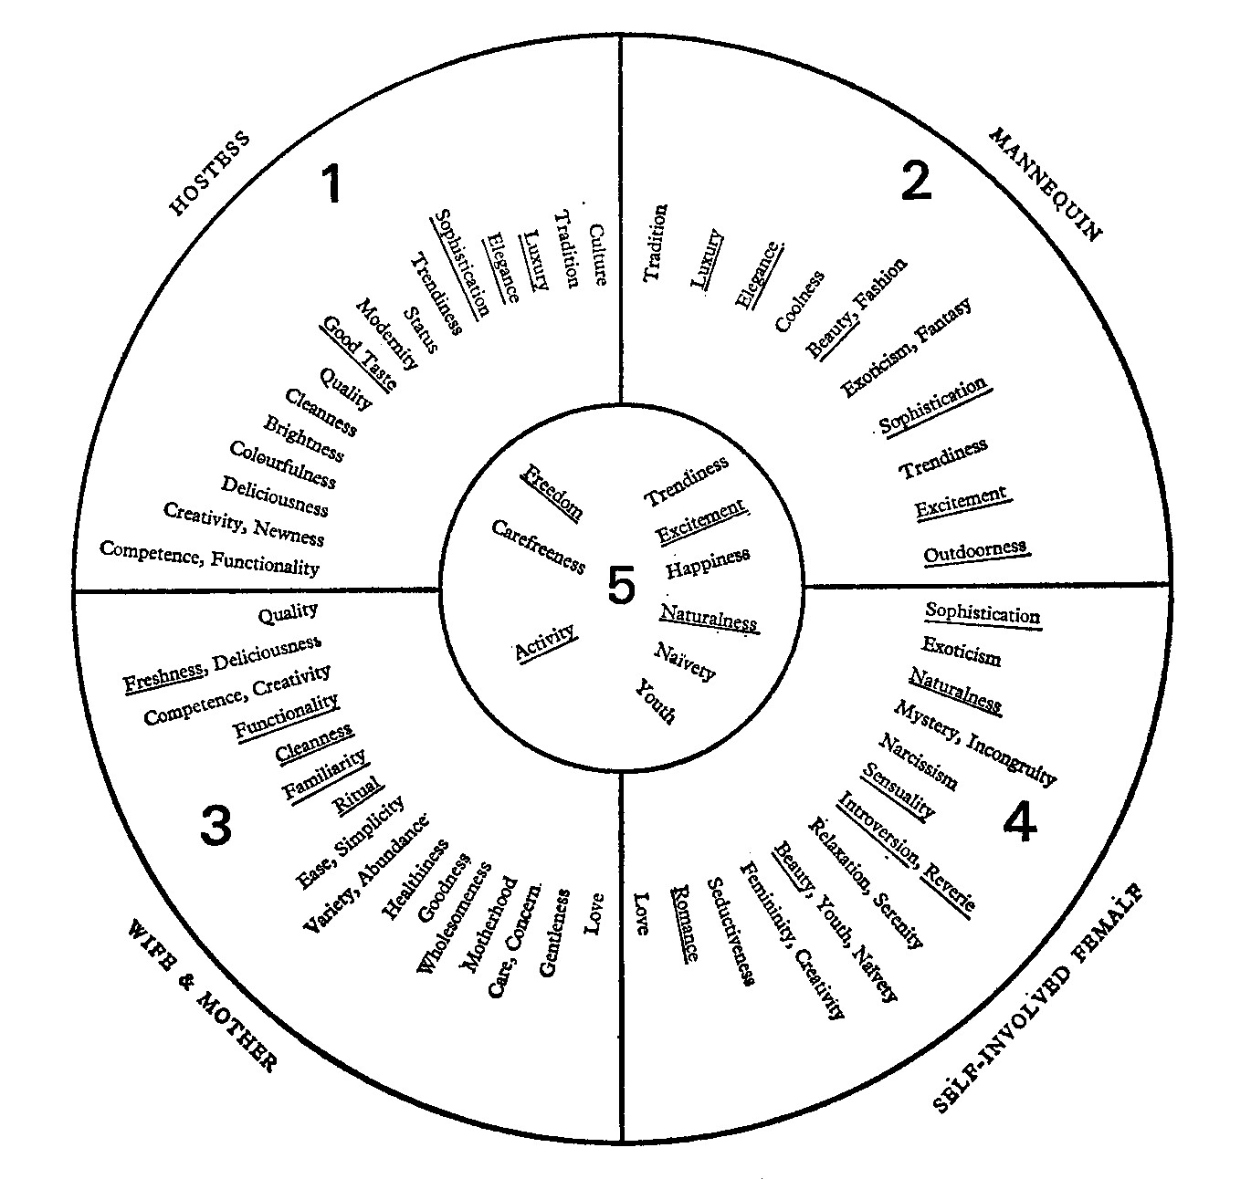
Notes:
Qualities associated with the categories

Slide 18
Notes:
Then…

Slide 19
Notes:
Now

Slide 20
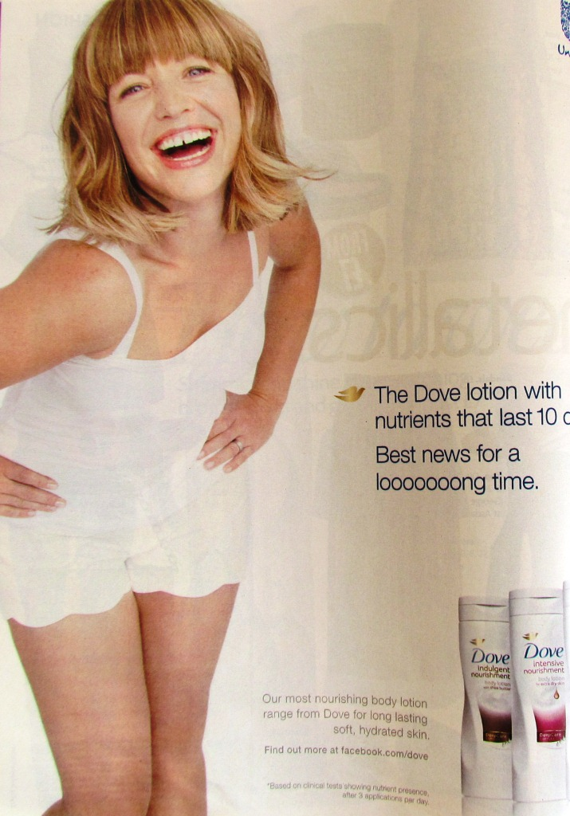
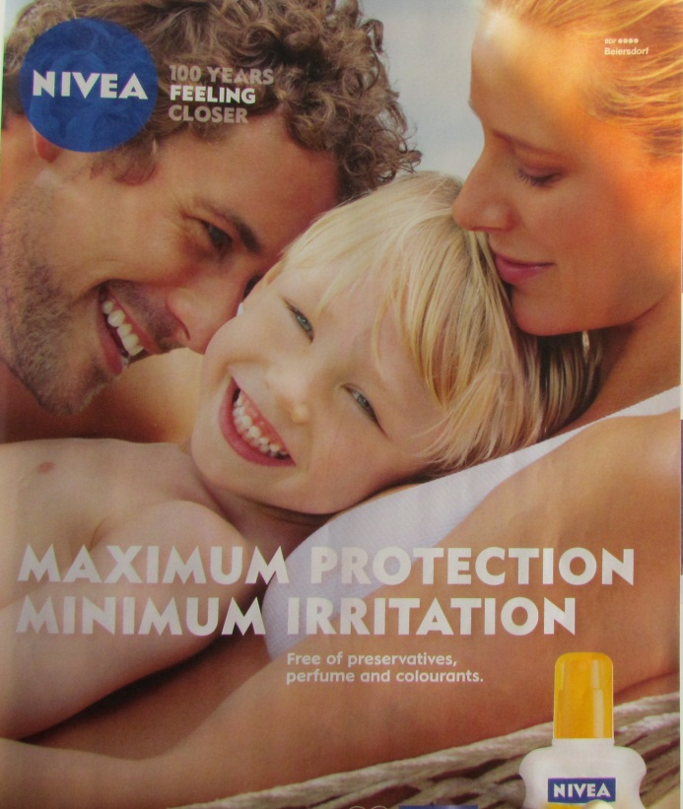
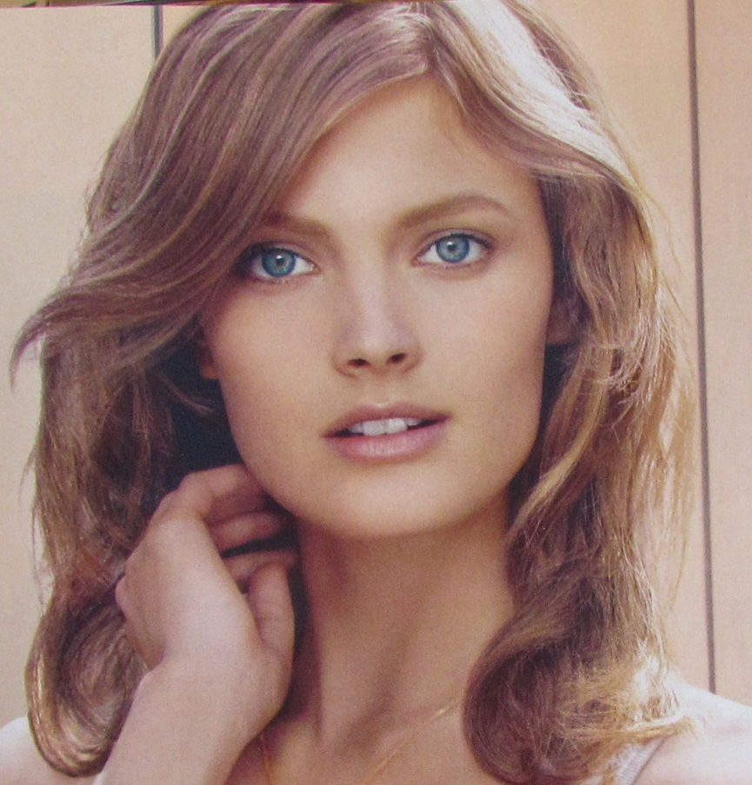
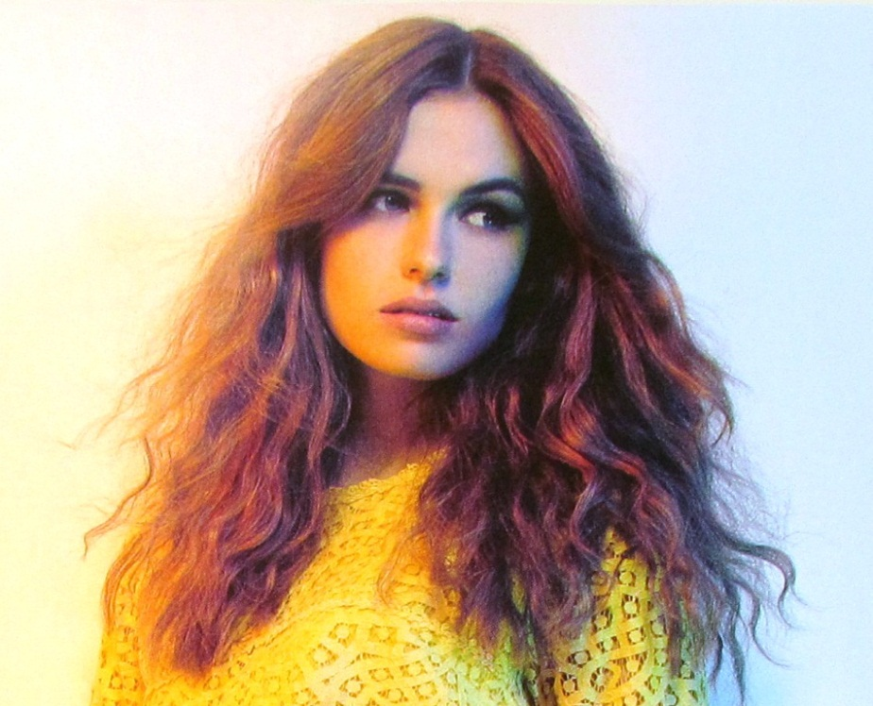
Narcissist image
Notes:
Examples

Slide 21
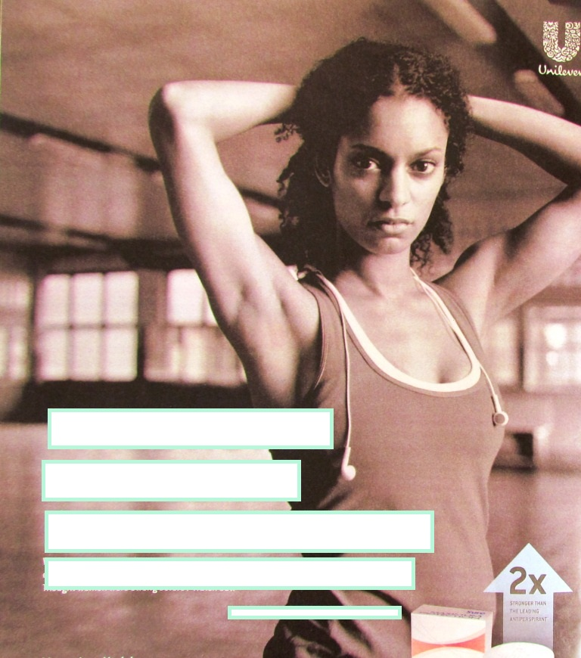
Notes:
Guess the text

Slide 23
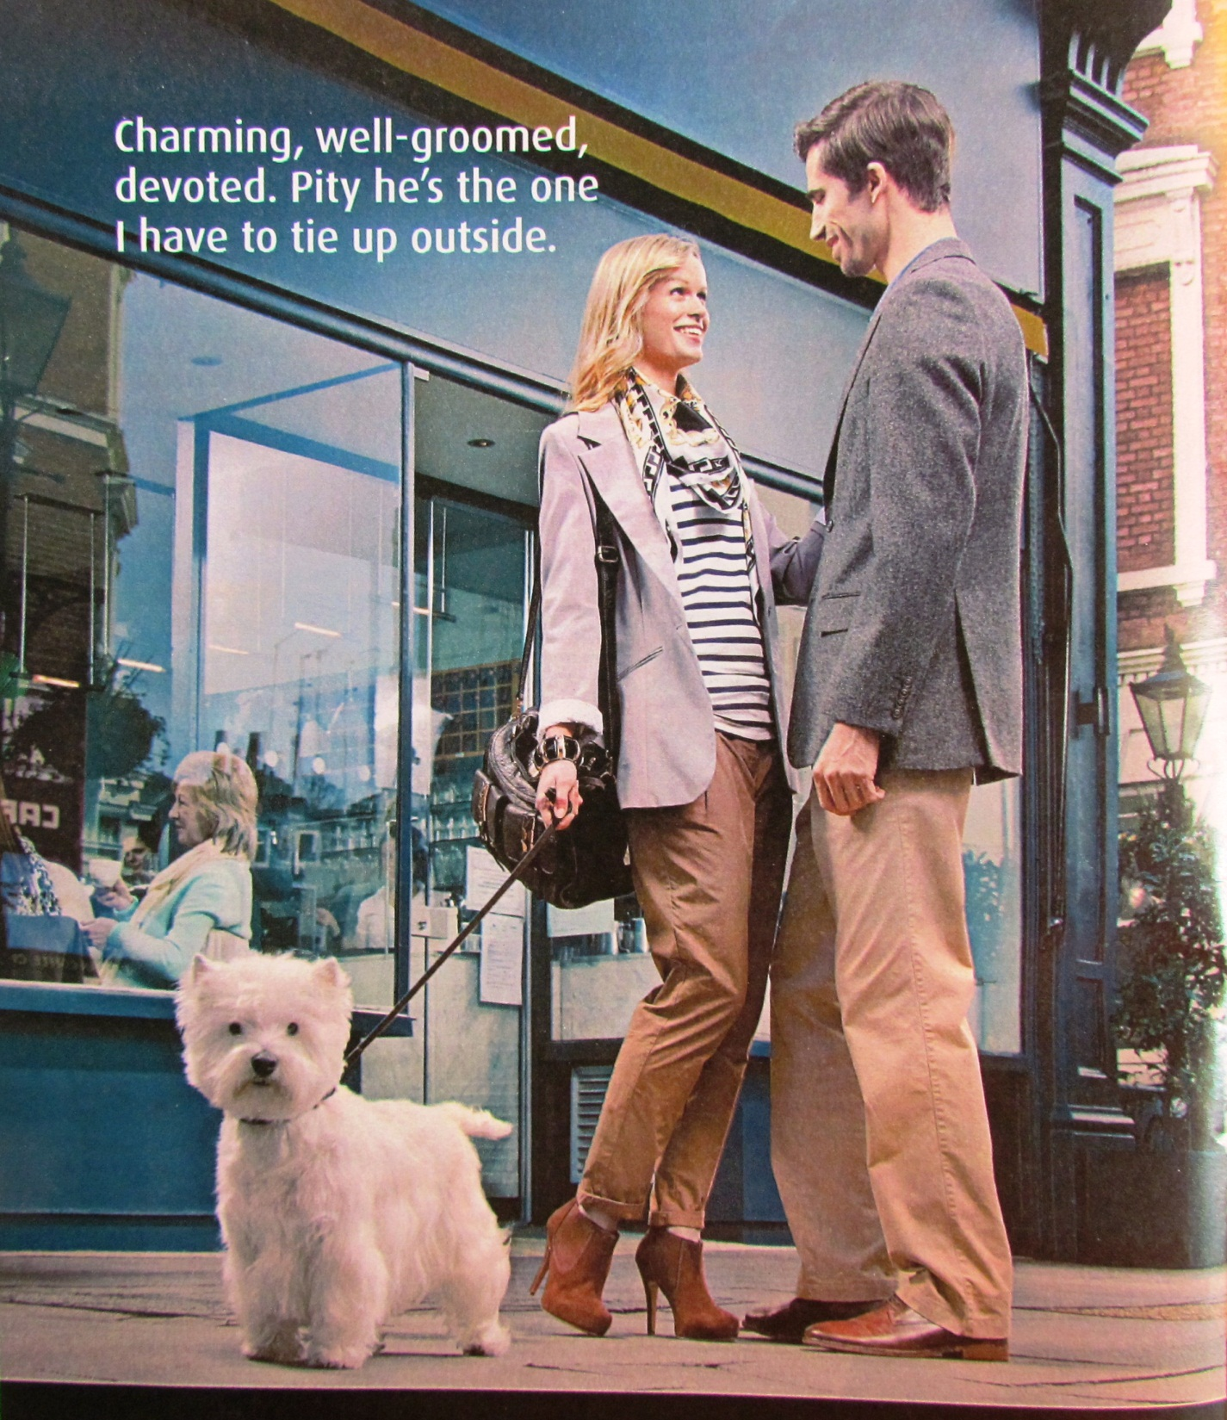
Notes:
Relationships…

Slide 24
Notes:
Relationships…
Interesting text but the picture tells a different story

Slide 25
In conclusion
The still pictorial image continues to carry powerful meanings – and is a necessary subject of analysis whether as editorial or advertising content.
It can be studied methodically and systematically, though it requires appropriate analytical tools – and patience.
In essence, the presentation of women in magazine advertising has changed very little over the last 50 years.

Slide 26
There is much more interesting work to be done, especially over time, comparing cultures, looking at age, ethnicity, other types of magazines, other types of advertising, comparing editorial images with advertising images.
Should you know anyone who would be interested in collaborating in further research or have any feedback, thoughts or observations, do contact me.

Slide 27
Images of Women: media stereotypes 1968 – 2018
Trevor Millum
www.readingpictures.co.uk
trevor@millum.myzen.co.uk

Slide 28
Additional notes
As before… feminism has made little or no impact on advertising images. The magazines themselves have changed a good deal, especially at the middle to lower end of the market. The glossy monthlies are less changed and show more resilience in the market. As do the more staid publications. Middle and lower range magazines have been taken over by celebrity gossip. Fiction has all but disappeared. Serious topics rarely tackled .
Editorial and advertising priorities:
How you look; how other women look; how you feel ; other women’s problems. The wider world might as well not exist.

